Slide 1
Introduktion til Programmering og Problemløsning (PoP)
Lister
Jon Sporring
Department of Computer Science
2022/9/29

Slide 2
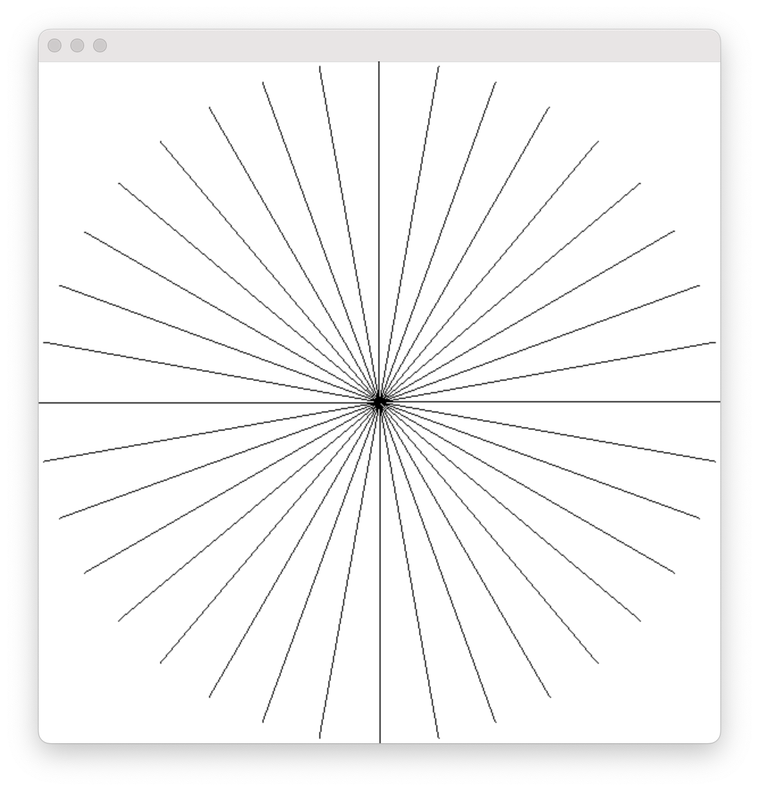
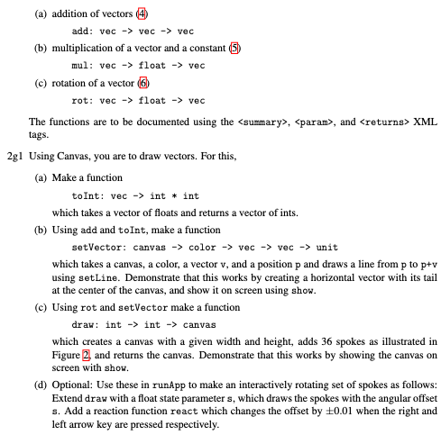
Gennemgang af afleveringsopgave 2g

Slide 3
Hvad er længden af lst m.m.
https://tinyurl.com/2etvjamj

Slide 4
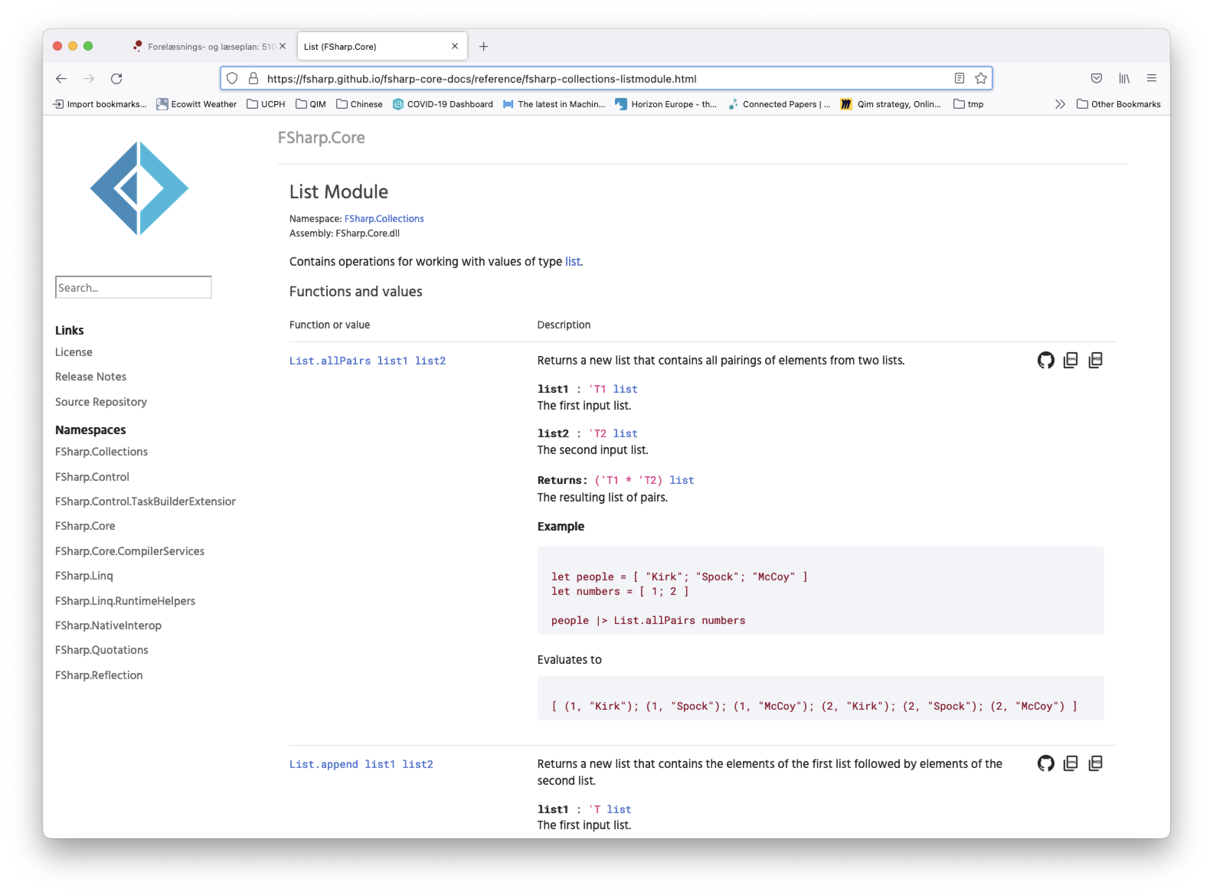
Listemodulet: https://fsharp.github.io/fsharp-core-docs/reference/fsharp-collections-listmodule.html

Slide 5
List.fold og List.foldBack
Hvad er typen?
% dotnet fsi
Microsoft (R) F# Interactive version 12.0.4.0 for F# 6.0
Copyright (c) Microsoft Corporation. All Rights Reserved.
For help type #help;;
> List.fold;;
val it: (('a -> 'b -> 'a) -> 'a -> 'b list -> 'a)
> List.foldBack;;
val it: (('a -> 'b -> 'b) -> 'a list -> 'b -> 'b)
Vilkårlig type ‘a og ‘b
val it: ((‘b -> ‘a -> ‘a) -> ‘b list -> ‘a -> ‘a)

Slide 6
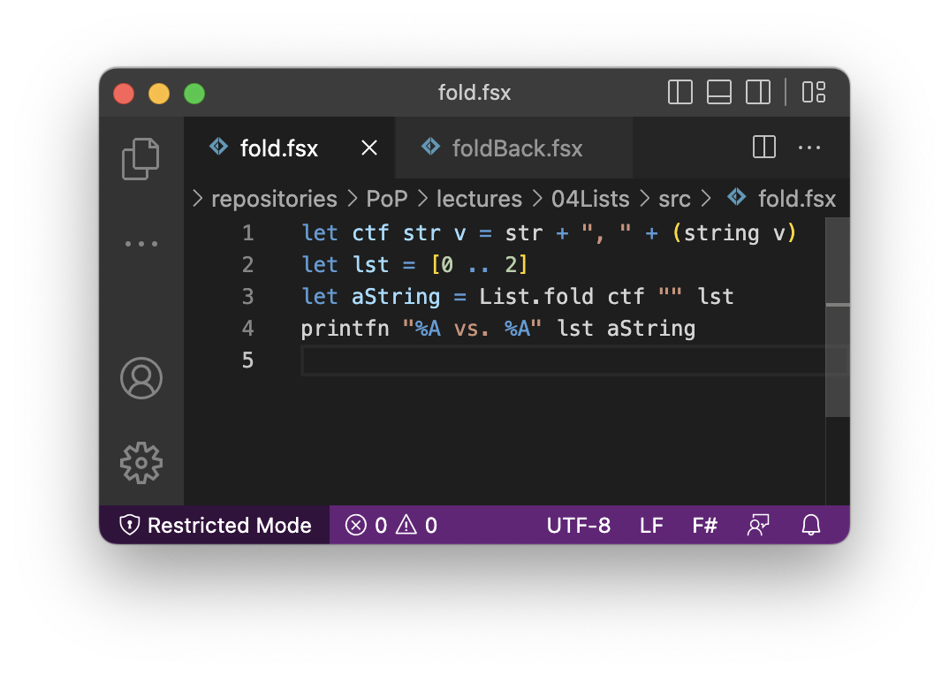
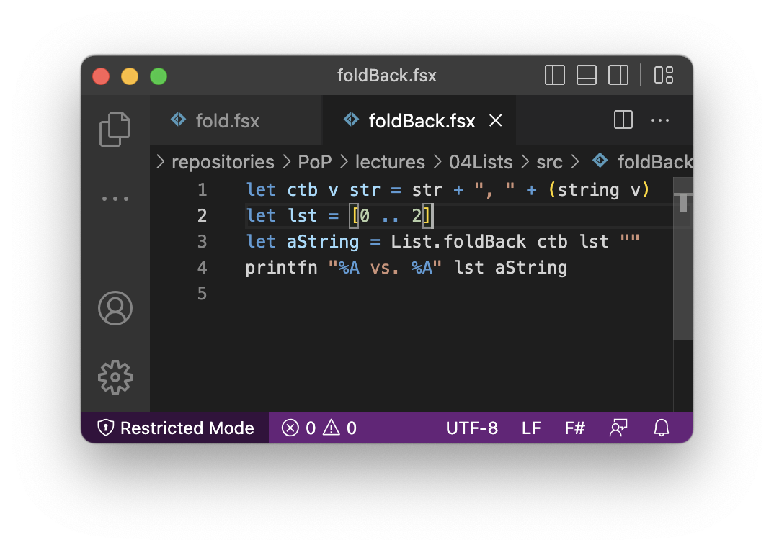
List.fold og List.foldBack
List.fold
List.foldBack
List.fold ctf "" [0 .. 2]
~> ctf (ctf (ctf "" 0) 1) 2
~> ctf (ctf ("" + ", " + "0") 1) 2
~> ctf (ctf ", 0" 1) 2
~> ctf (", 0" + ", " + "1") 2
~> ctf ", 0, 1" 2
~> ", 0, 1" + ", " + "2"
~> ", 0, 1, 2"
List.foldBack ctf [0 .. 2] ""
~> ctb 0 (ctb 1 (ctb 2 ""))
~> ctb 0 (ctb 1 ("" + ", " + "2"))
~> ctb 0 (ctb 1 ", 2")
~> ctb 0 (", 2" +", " + "1")
~> ctb 0 ", 2, 1"
~> ", 2, 1" + ", " + "0"
~> ", 2, 1, 0"

Slide 7
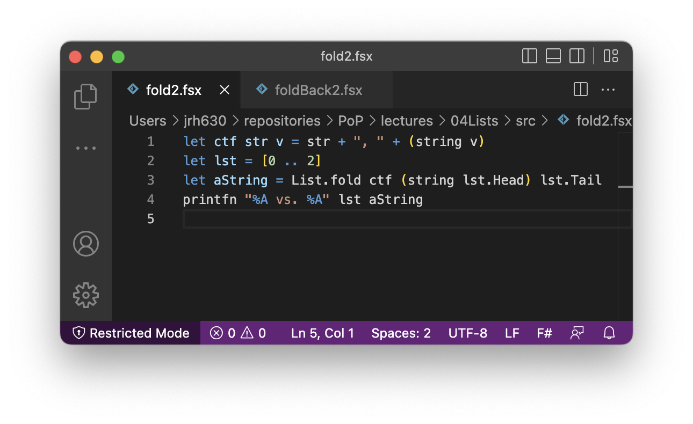
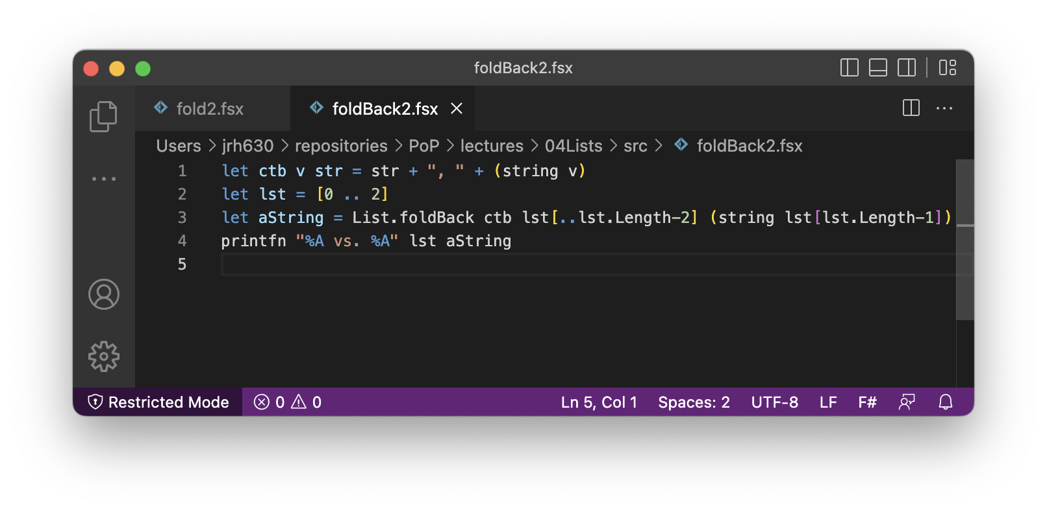
Hvordan undgår mand det foranstillede “, “?
List.fold
List.foldBack
% dotnet fsi fold2.fsx
[0; 1; 2] vs. "0, 1, 2"
% dotnet fsi foldBack2.fsx
[0; 1; 2] vs. "2, 1, 0"

Slide 8
List.fold og List.foldback med anonyme funktioner
Sum en liste af heltal:
let add a b = a+b
List.fold add 0 [1..5]
List.fold (fun acc elm -> acc + elm) 0 [1..5]
List.foldBack (fun elm acc -> acc + elm) [1..5] 0
Sekvens af udtryk
Debugging med printfn og sekvenser af udsagn:
List.fold (fun acc elm -> printfn "(%d,%d)" elm acc; acc + elm) 0 [1..5]
List.foldBack (fun elm acc -> printfn "(%d,%d)" elm acc; acc + elm) [1..5] 0

Slide 9
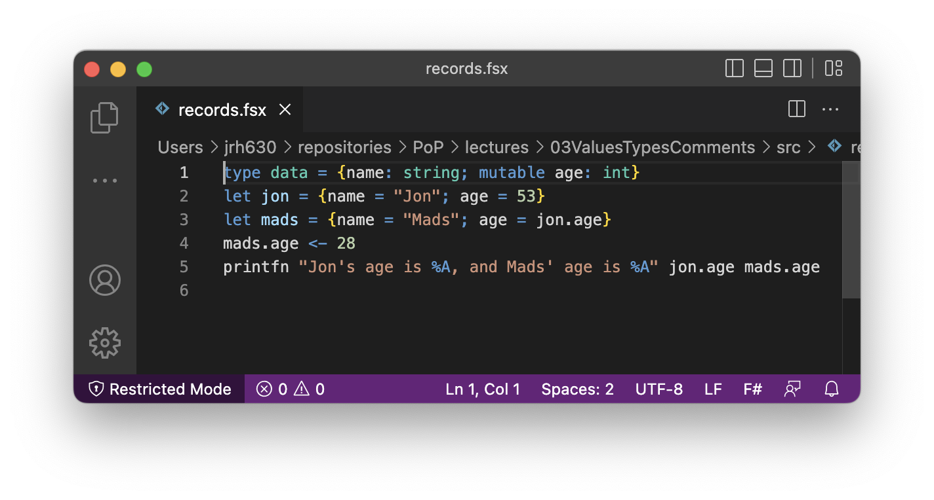
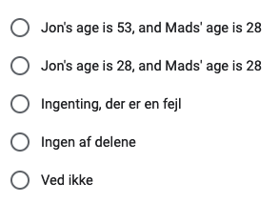
Hjernevrider uge 3

Slide 10
Spørgsmål

